Slide 1

Innovation Day Sponsored by: Single-Family Front-End Technology Capital Markets Technology
August 23, 2018
Property Monitoring Kit

Slide 2
Introduction
ITEM | Description
Project Name | Property Monitoring Kit
Problem Statement | How does Fannie Mae ensure that REO properties remain in good condition until they are sold?
Team Members | Scott Nestor, Kashi Dasa, Sagar Allamshetty, Tim Burns
Technologies used | Elixir, AWS

Slide 3
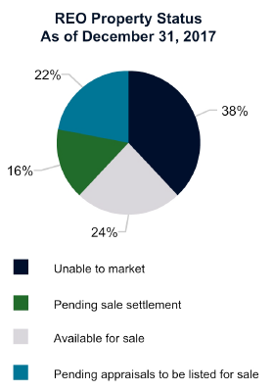
The Problem
By the end of 2017:
$521M of foreclosed property expenses
26K properties (over 16K marketable)
Questions:
How does Fannie Mae monitor the condition of these properties?
How can Fannie Mae avoid sinking extra money into repairs?
Innovation Day | August 23rd 2018

Slide 4
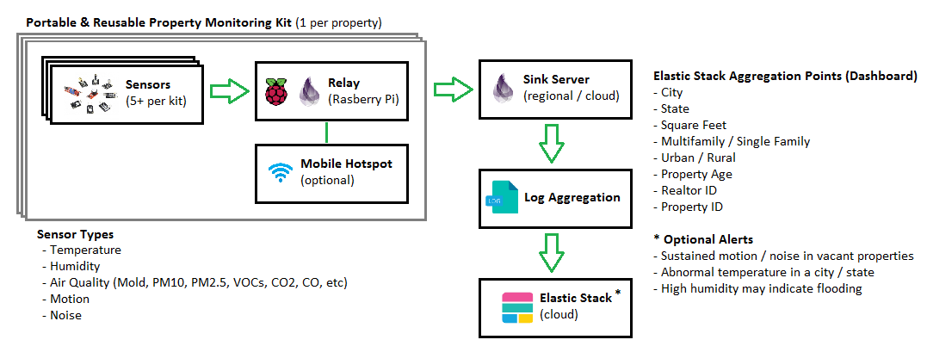
The Solution: Property Monitoring Kit
Innovation Day | August 23rd 2018

Slide 5
Property Monitoring Kit: Demo
Innovation Day | August 23rd 2018

Slide 6
Applicability: Property Monitoring Kits
Fannie Mae can use Property Monitoring Kits to ensure that marketable REO properties remain in good condition (to avoid additional repair cost/value loss)
Stakeholders:
Fannie Mae (REO Portfolio Managers, Multifamily Guarantee)
Realtors Selling Property
Property Managers
Learned:
Elixir, Client/Server Socket Integration
Elastic Search in AWS
REO Properties, Fannie Mae Financials, Sensor technology
Additional Benefits:
Fannie Mae PR for occupied properties
Smart home/hobbyist use outside Fannie Mae

Slide 7

Questions and Answers!

Slide 8
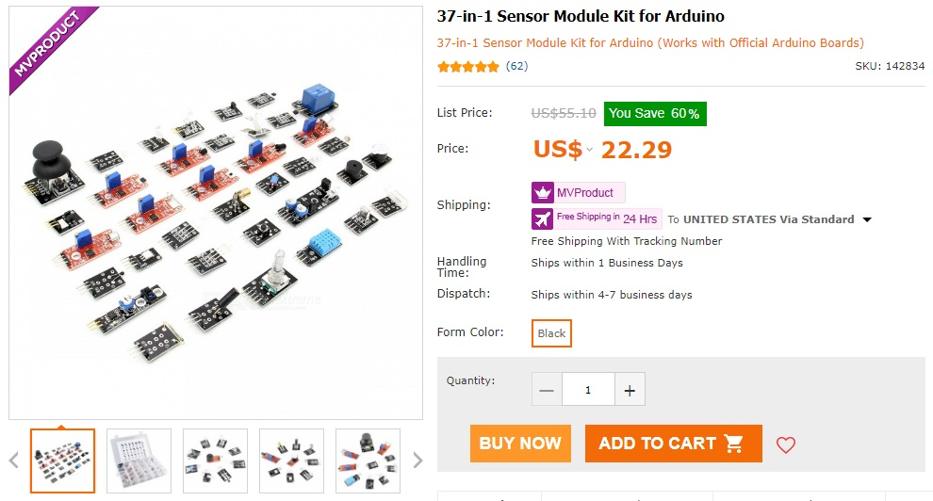
Appendix: Arduino Sensor Cost
Innovation Day | August 23rd 2018

Slide 9
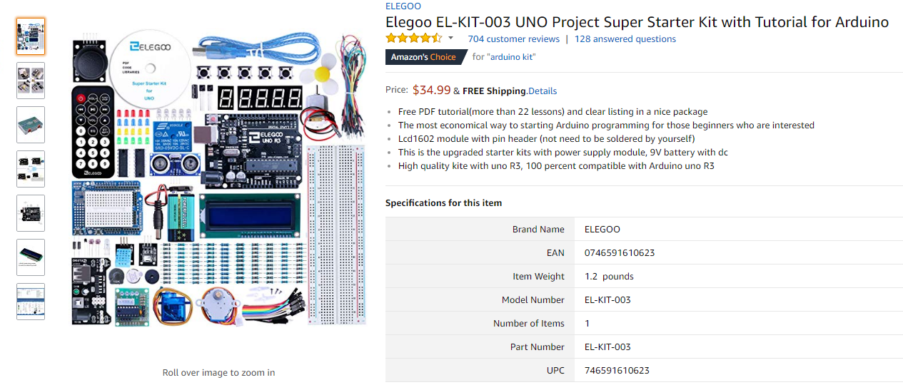
Appendix: Arduino Kit Cost
Innovation Day | August 23rd 2018

Slide 10

Appendix: Raspberry Pi Kit Cost (Relay)
Innovation Day | August 23rd 2018

Slide 11
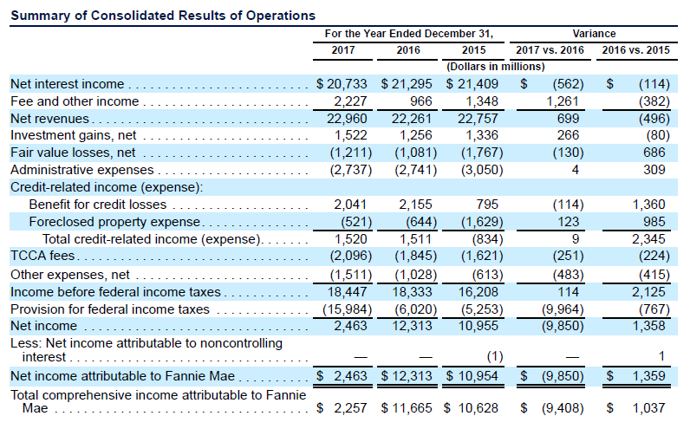
Appendix: 2017 10-K Report Page 59
Innovation Day | August 23rd 2018

Slide 12
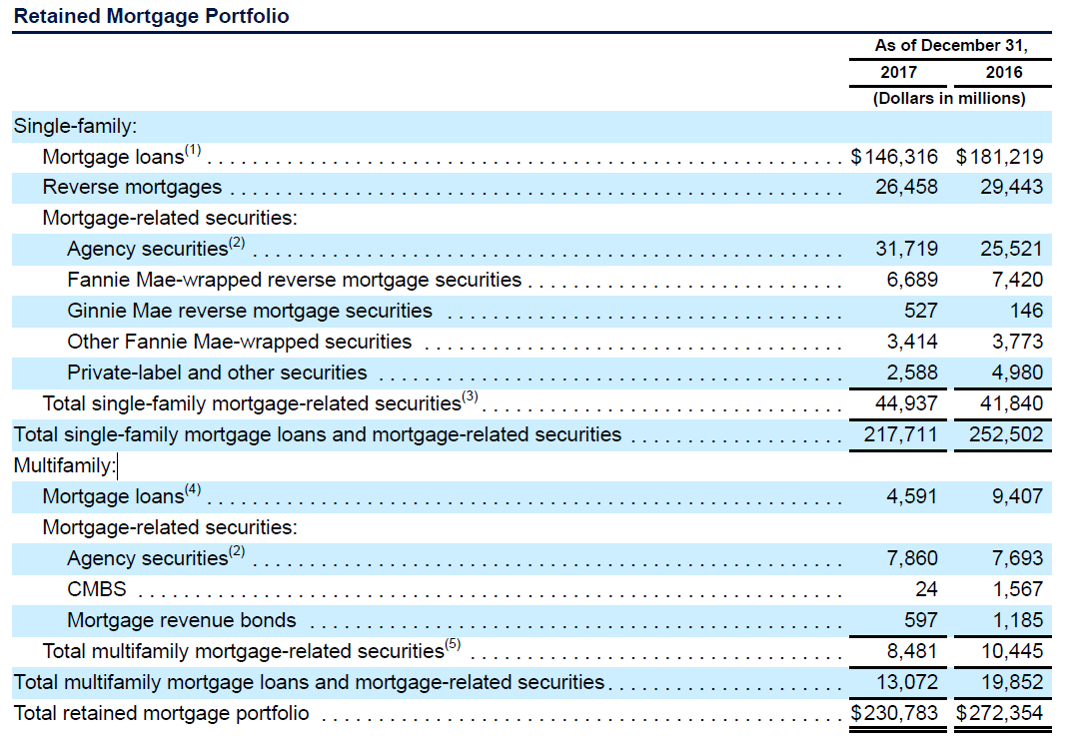
Appendix: 2017 10-K Report Page 71
Innovation Day | August 23rd 2018

Slide 13
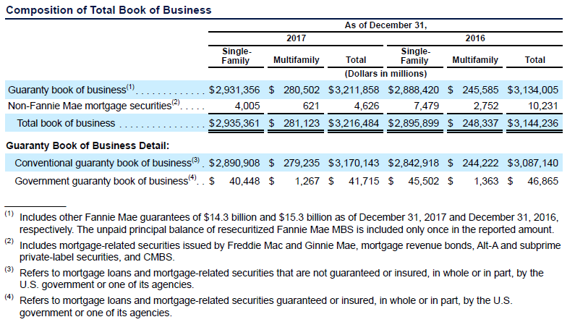
Appendix: 2017 10-K Report Page 72
Innovation Day | August 23rd 2018

Slide 14
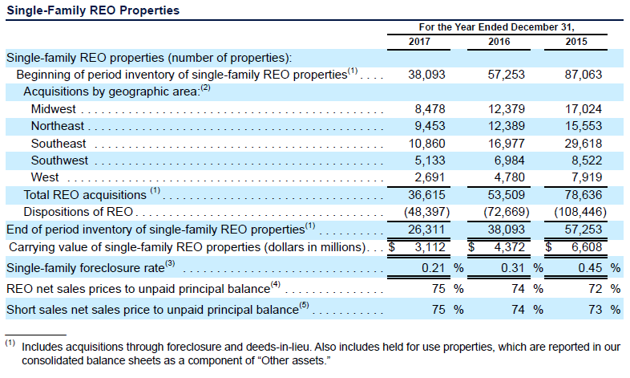
Appendix: 2017 10-K Report Page 98
Innovation Day | August 23rd 2018

Slide 15
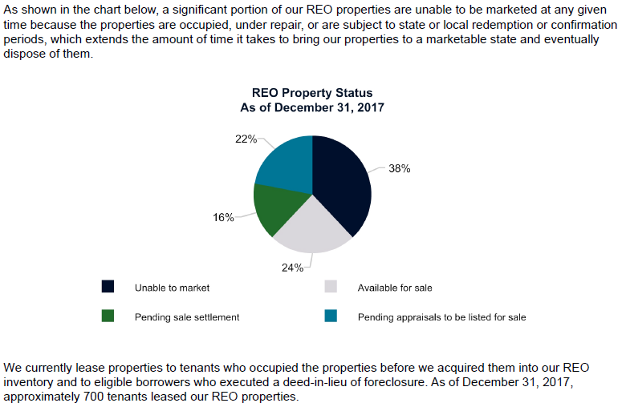
Appendix: 2017 10-K Report Page 99
Innovation Day | August 23rd 2018

